Slide 1


SIMATS ENGINEERING
SAVEETHA INSTITUTE OF MEDICAL AND TECHNICAL SCIENCES
Technical Presentation
29.Database Indexing using B-Tree
CSA0310 – DATA STRUCTURE
Presented by:
RISHIK JK (192511052)
B.E.CSE

Slide 2
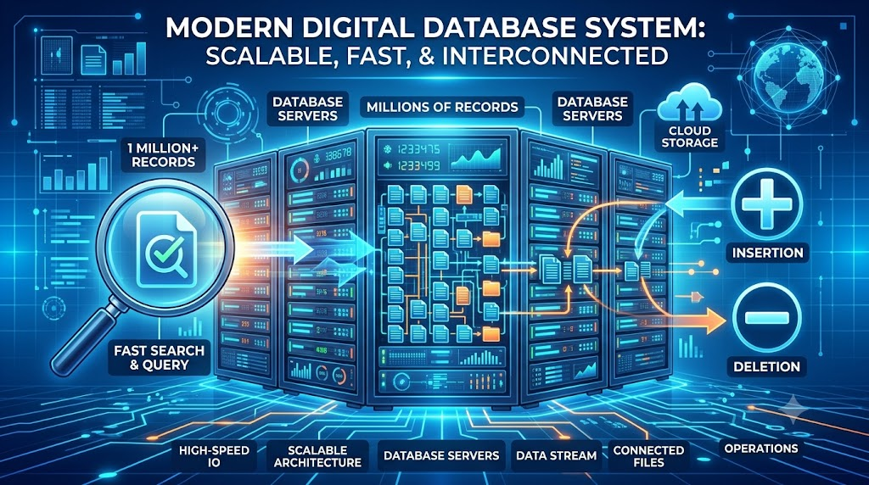
Problem Statement
A database indexing system requires:
🔹 Fast searching of records
🔹 Fast insertion of new data
🔹 Fast deletion of existing data
🔹 Efficient use of disk storage
🔹 High performance for large databases
Challenge: Traditional data structures may become slow when handling large databases. Therefore, an efficient tree data structure is required to maintain high performance.

Slide 3
Recommended Data Structure: B-Tree
What is a B-Tree?
A B-Tree is a self-balancing multi-way search tree designed for efficient data storage
Key Features
Self-balancing structure
Stores multiple keys in a single node
Keeps data in sorted order
Reduces the height of the tree
Minimizes disk access

Slide 4
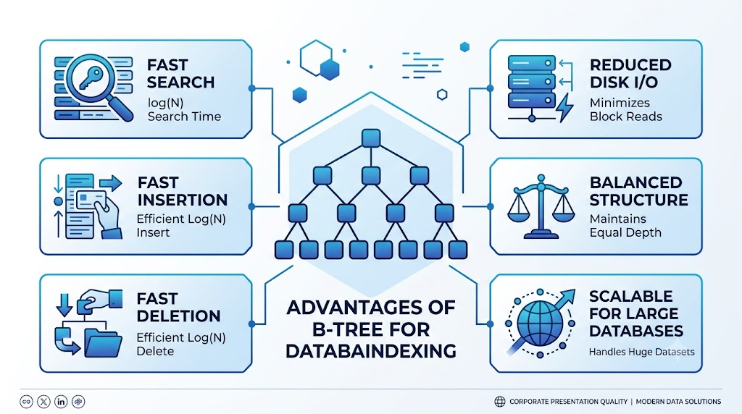
Applications of Digital Filtering
Mobile Cameras – Improves photo quality and removes noise.
CCTV Surveillance – Enhances video clarity for better monitoring.
Medical Imaging – Improves X-ray, MRI, and CT scan images.
Satellite Imaging – Enhances Earth observation and weather images.
Autonomous Vehicles – Helps cameras detect roads, objects, and obstacles.

Slide 5
Conclusion
B-Tree is the most suitable tree data structure for database indexing.
It provides fast searching, insertion, and deletion with O(log n) time complexity.
Its self-balancing structure ensures consistent performance.
It reduces disk access, making it ideal for large databases.
Therefore, B-Tree is widely used in modern Database Management Systems (DBMS).
“ B-Tree improves database performance by enabling efficient indexing, faster data retrieval, and optimized storage management."

